Slide 1


Developing and Deploying Microservices with Tye
David Fowler
Glenn Condron

Slide 2
What are we talking about today?
As you saw in the keynote it’s tooling for building and deploying multi-service apps to Kubernetes.
Talk Links:
.NET Conf 2020 Keynote
Kubecon Talk
BUILD 2020 Talk
Community Standup

Slide 3
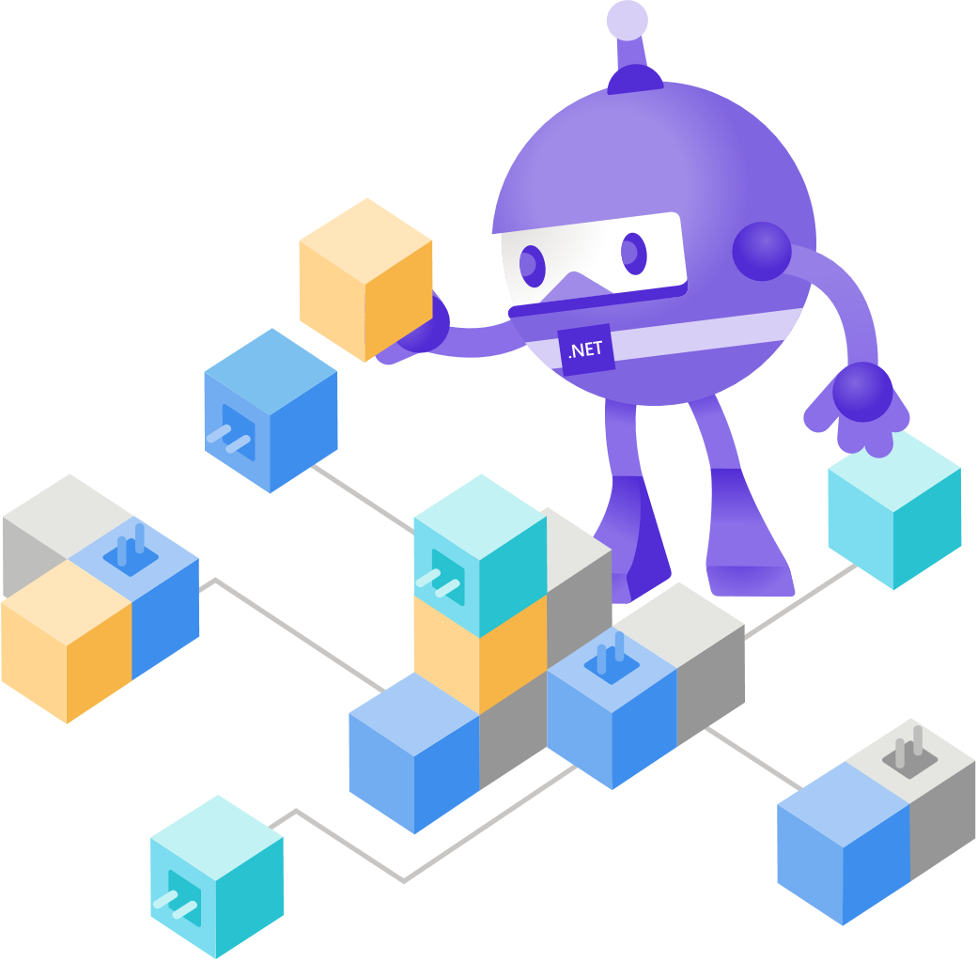
Why did we start Tye?
Flatten the learning curve for .NET developers trying to build Microservices and use Kubernetes
Kubernetes
Complexity
Tye
Time

Slide 4
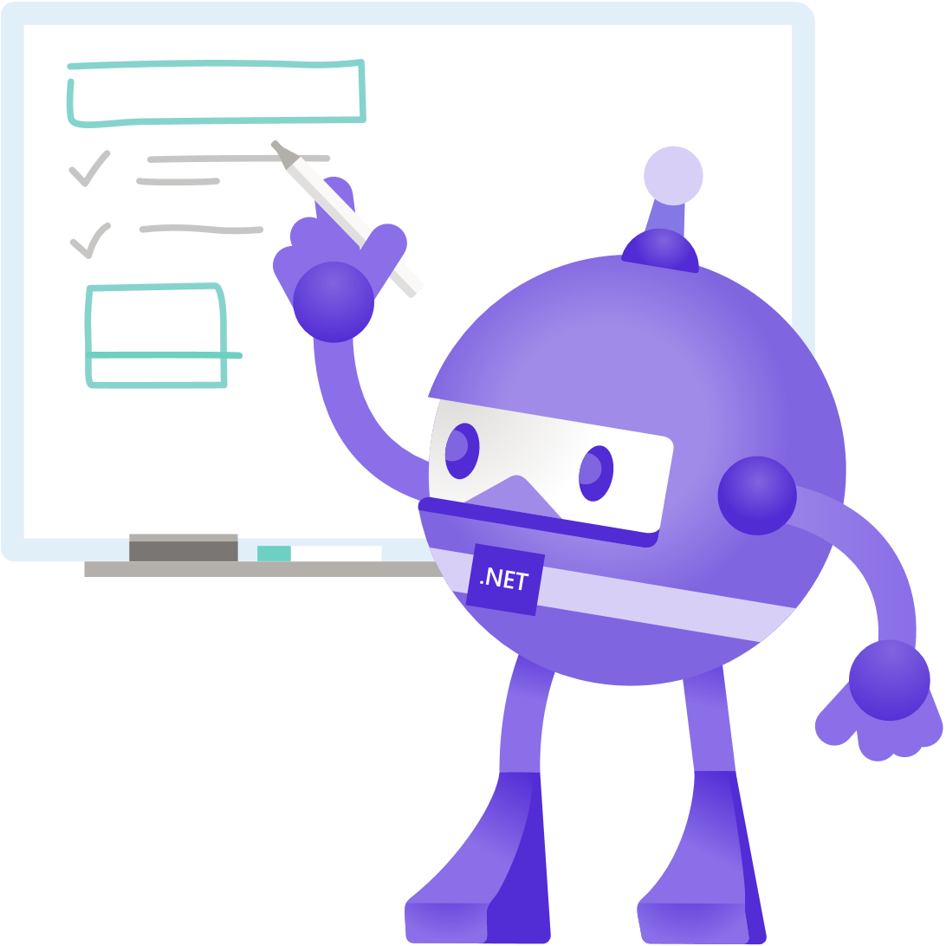
Why an experiment?
Understand how people are building apps today
Understand how we can best fit into that flow
Understand the what’s really a problem
Understand the limitations/potential of existing tech
‘Any fool can know. The point is to understand.’ –Albert Einstein

Slide 5

Tye Survey
The following data comes primarily from our Tye survey. If you’ve used Tye and not filled it out, we’d love to hear from you.
https://aka.ms/tyesurvey

Slide 6
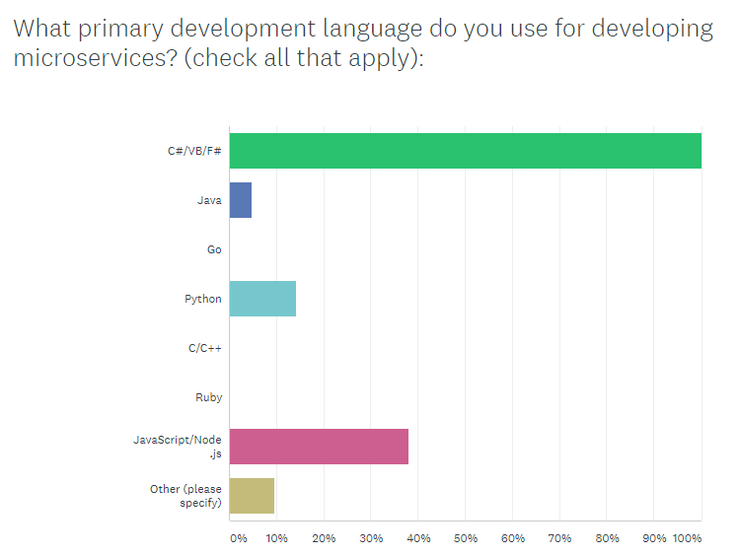
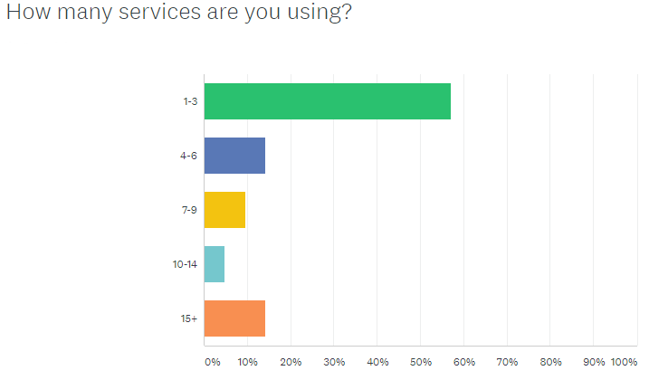
What did we learn?

Slide 7
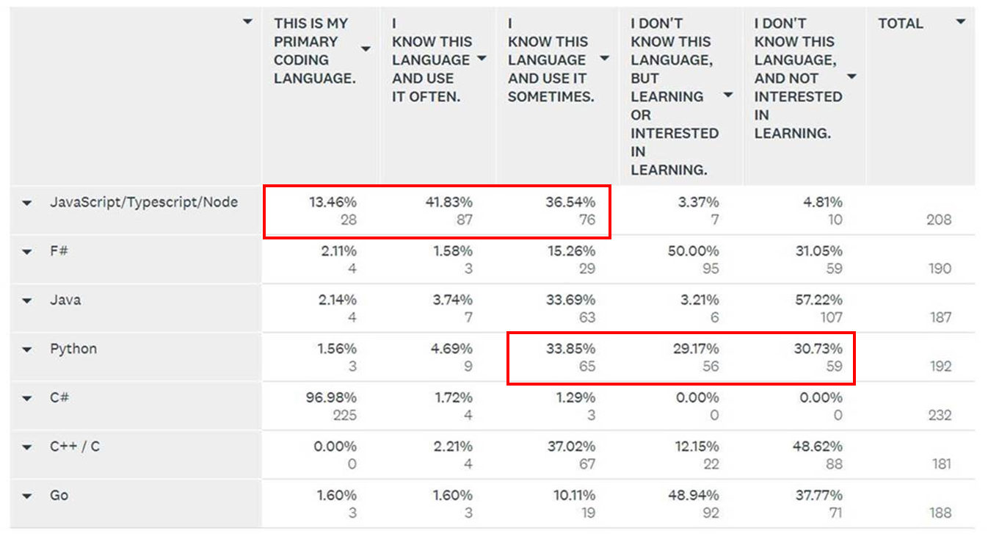
What did we learn?
Details on Languages from a different survey:
Takeaway:
Microservices are polyglot….ish.
Most people have JS (frontends).
Lots of people are interested in Python.

Slide 8
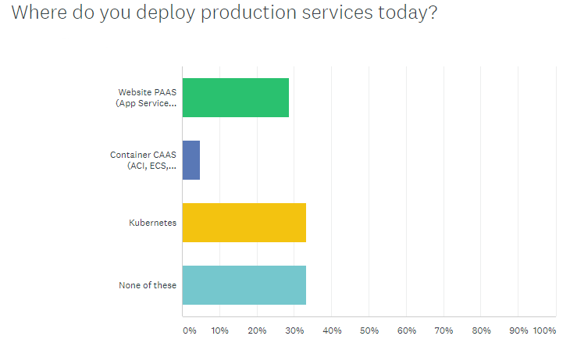
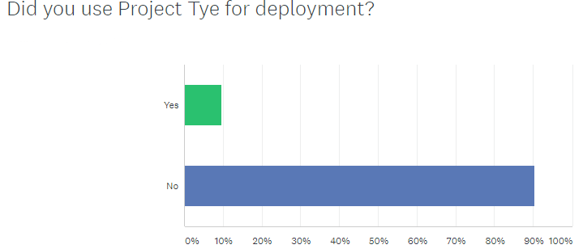
What did we learn?

Slide 9
What did we learn?
Microservices are had for junior developers, Tye is really helping me learn
"FINALLY - someone cares about developing microservices and running locally. I don't need to write 100 Dockerfiles, write scripts, pass environment variables, add nuget packages, write dashboards, wire it all up.... "it just works“
Easy to setup has support for ELK/Zipkin
SSL errors made it impossible to use
Lack of documentation
Debugging is hard
Can’t satisfy my custom deployment requirements

Slide 10
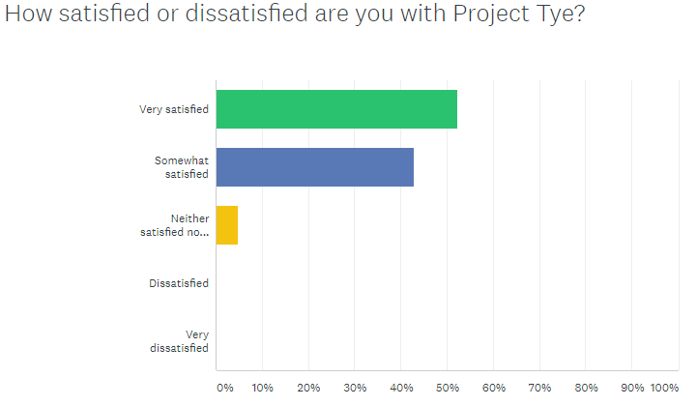
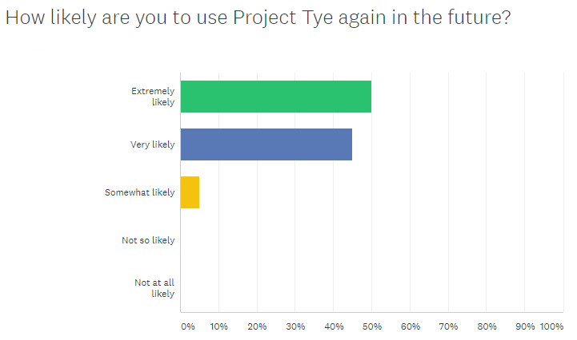
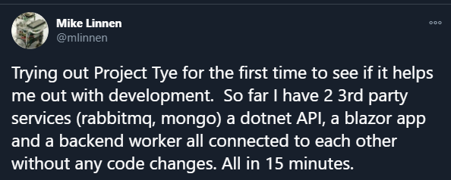
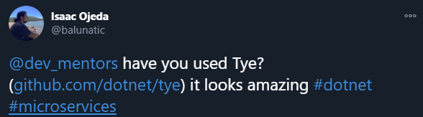
What did we learn?

Slide 11
Demos

Slide 12
What’s next?
VS Code extension
VS Integration
Functions Deployment
Docker compose interop

Slide 13
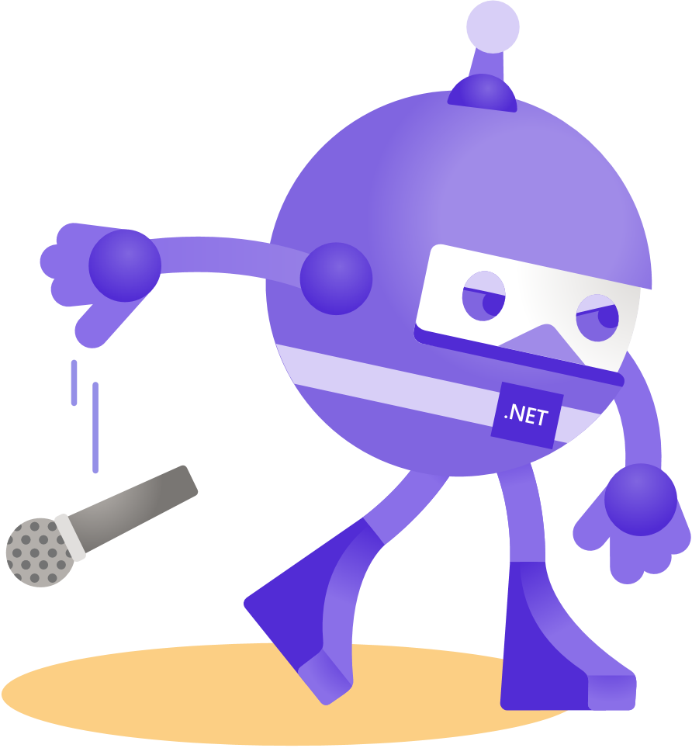
Thanks for joining!

